Slide 2
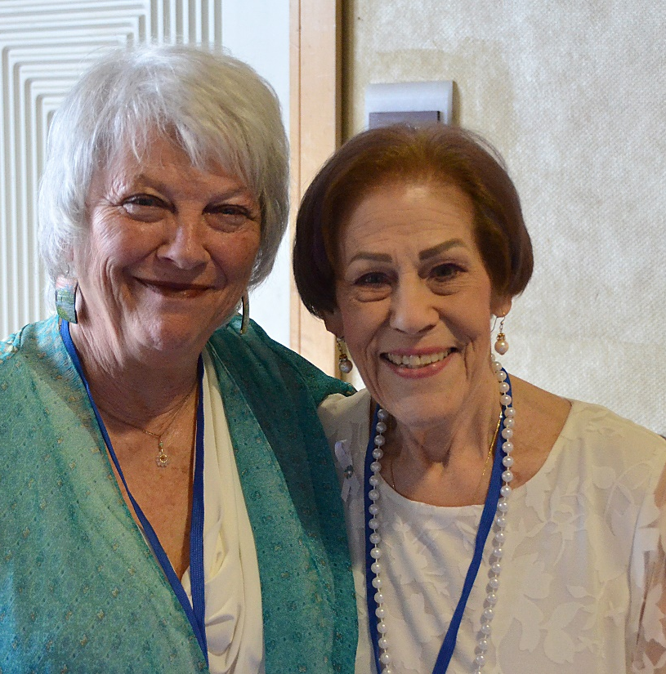
The Victory Center’s mission is to provide hope and support to cancer patients, survivors, and those closest to them. All of our services are free-of-charge thanks to the generosity of people like you!
Presented by

Slide 3
A SPECIAL THANK YOU TO OUR
Presenting Sponsor

Slide 4
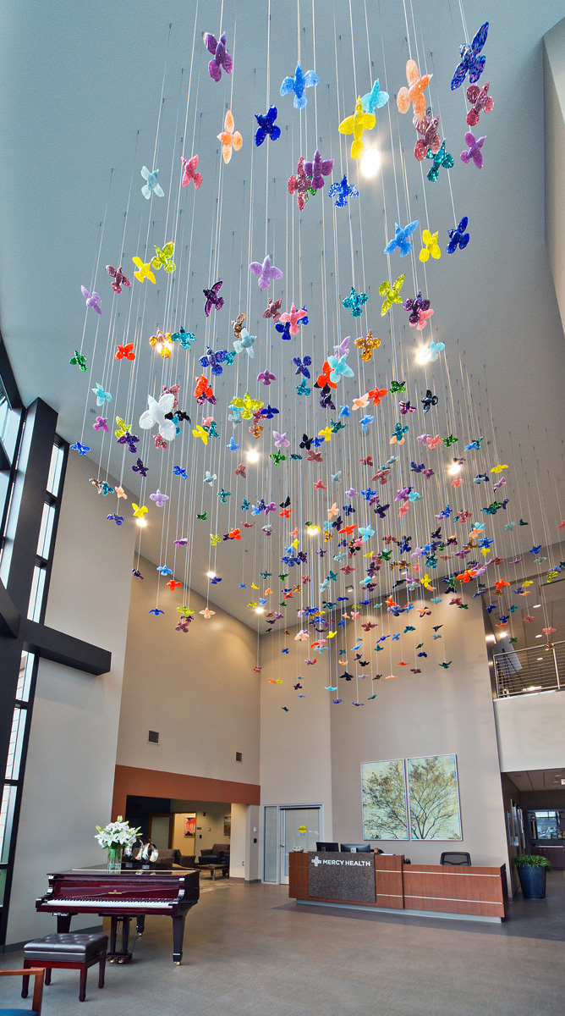

Slide 5
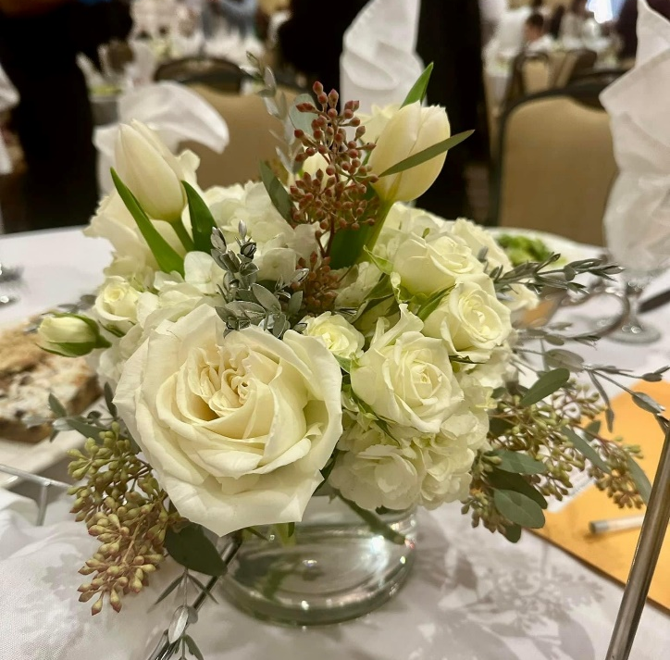
Bartz Viviano for the beautiful, fresh floral centerpieces! Today’s flowers are available to purchase for just $30. Please pay at the Credit Card table in the lobby following the show!
Thank you!
Presented by

Slide 6
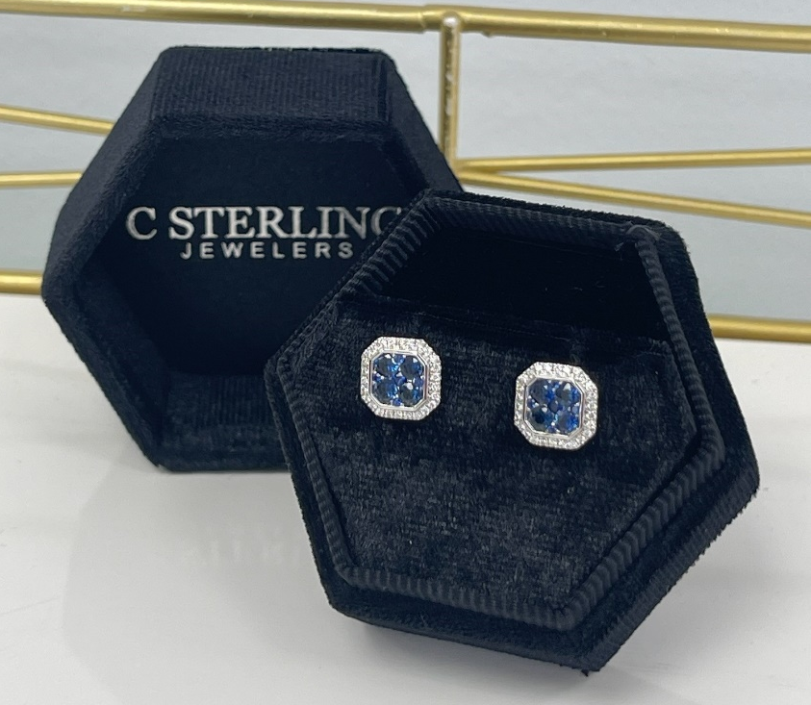
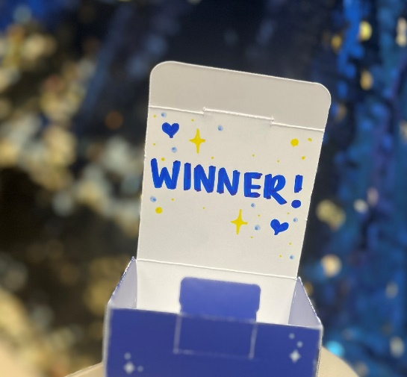
C Sterling Jewelers generously donated a pair of 14K white gold, natural diamond and sapphire earrings valued at over $2,200 for one lucky winner! Everyone else gets a beautiful pair of faux sapphire and diamond earrings. Only 350 pair available!
Have you purchased your mystery earrings yet?
Look for THIS box!
Presented by

Slide 7
A SPECIAL THANK YOU TO OUR
Fashionista Sponsor

Slide 8
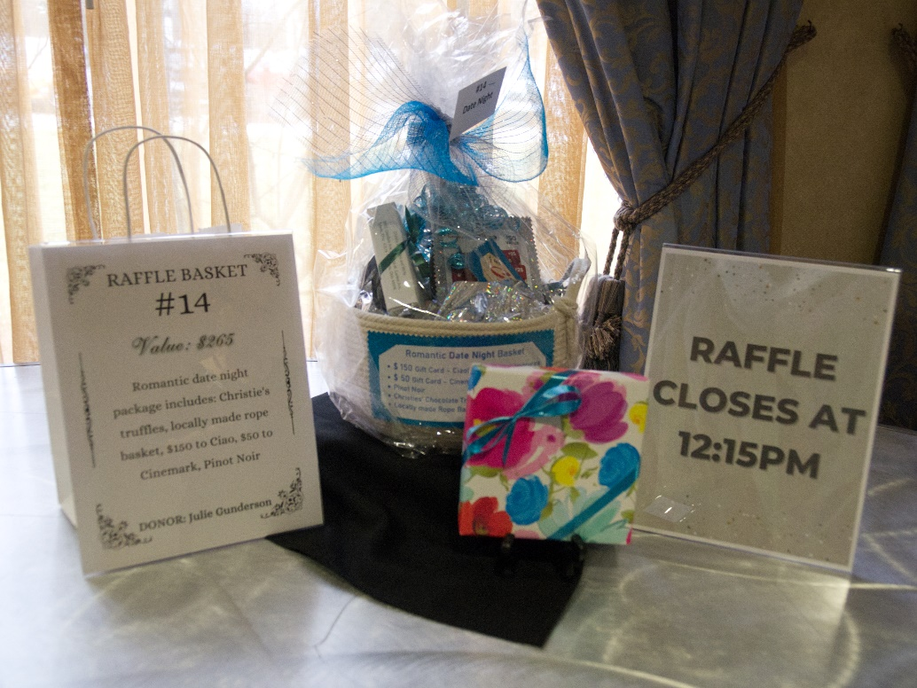
Raffle baskets CLOSE at 12:15 PM
Presented by

Slide 9
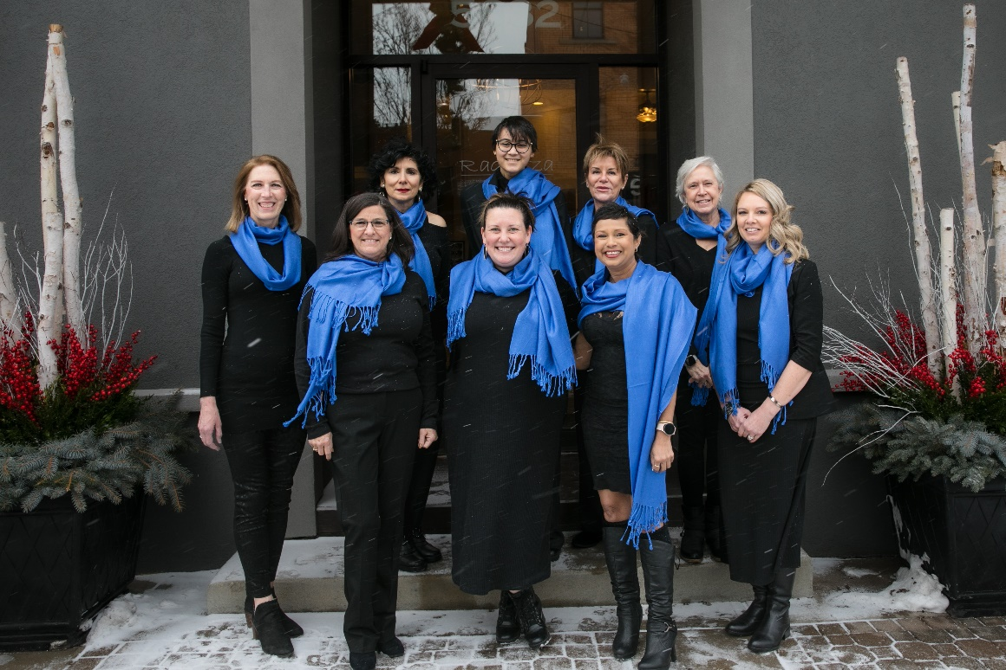
Meet today’s Featured Survivor Models
Seth Bidlack
Michael Frankhouse
Heather Ogdahl
Charlotte Savage
Mona Shousher
Cindy Siler
Julie Snyder
Ren Watkins
Presented by

Slide 10
Today’s Boutiques
Presented by

Slide 11
Door Prize tickets can be entered to win a $500 portrait session, compliments of With Love Photography. One entry per sheet of raffle tickets purchased.
Presented by

Slide 12
A SPECIAL THANK YOU TO OUR
Catwalk Sponsors

Slide 13
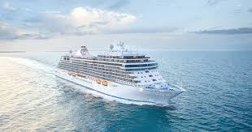
Buy your Victory Sweepstakes Tickets!
1st Prize is a $3,000 voucher with Central Travel!
$20
Presented by

Slide 14
Buy your Victory Sweepstakes Tickets!
2nd Prize
Professional laser treatment & skincare products
$20
3rd Prize
Sapphire & diamond necklace
Presented by

Slide 15
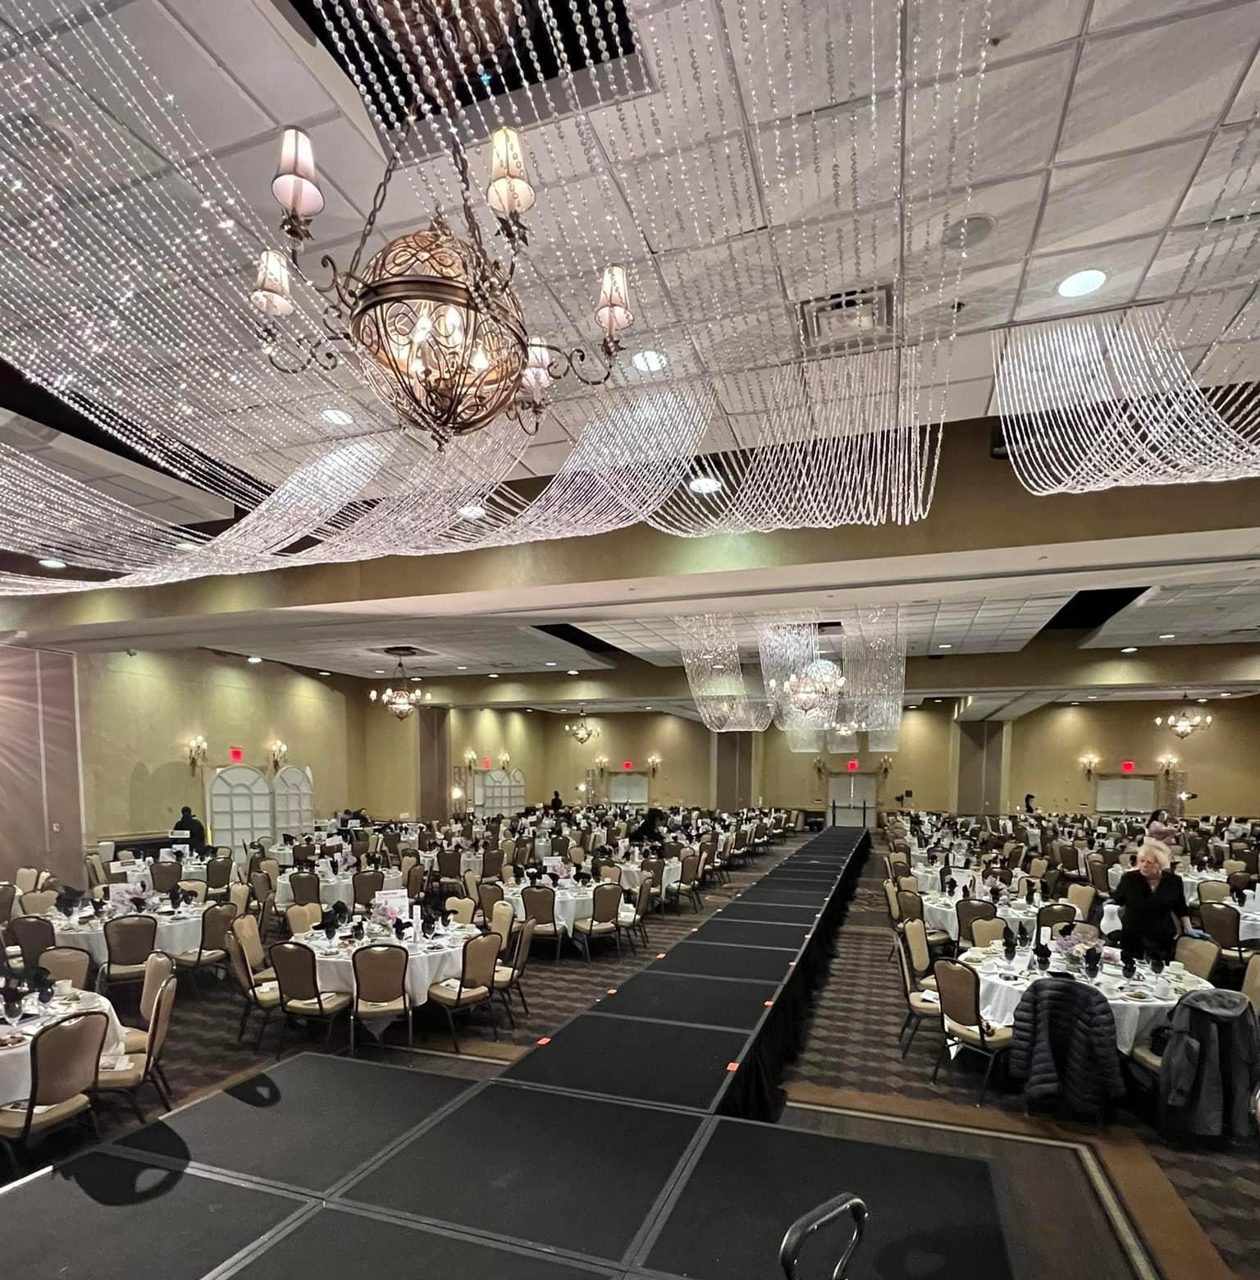
Stunning lobby & ballroom décor by:
Presented by

Slide 16
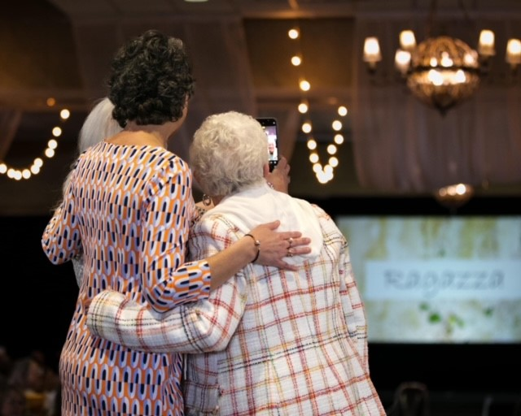
A Special Thank You To Our
Planning Committee!
Sally Baas
Dianne Barndt
Melissa Chevalier
Vicki Fesh
Becky Johnson
Jackie Klempner
Michele Kress
MaryAnn Mills
Mona Qaimari
Brie Rapp
Kimberly Rosinski
Connie Spevak
Katrina Trombley
Cheryl Walter
Ren Watkins
Jane Wurth
Presented by

Slide 17
A Special Thank You To Today’s Table Display Sponsors:
Presented by

Slide 18
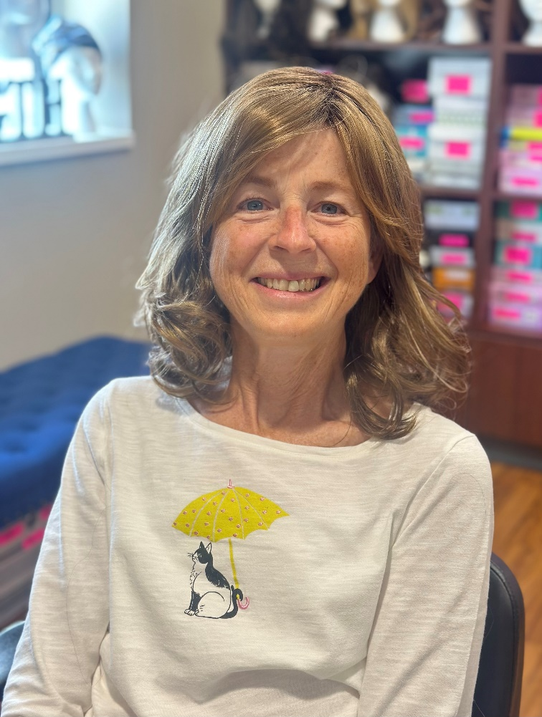
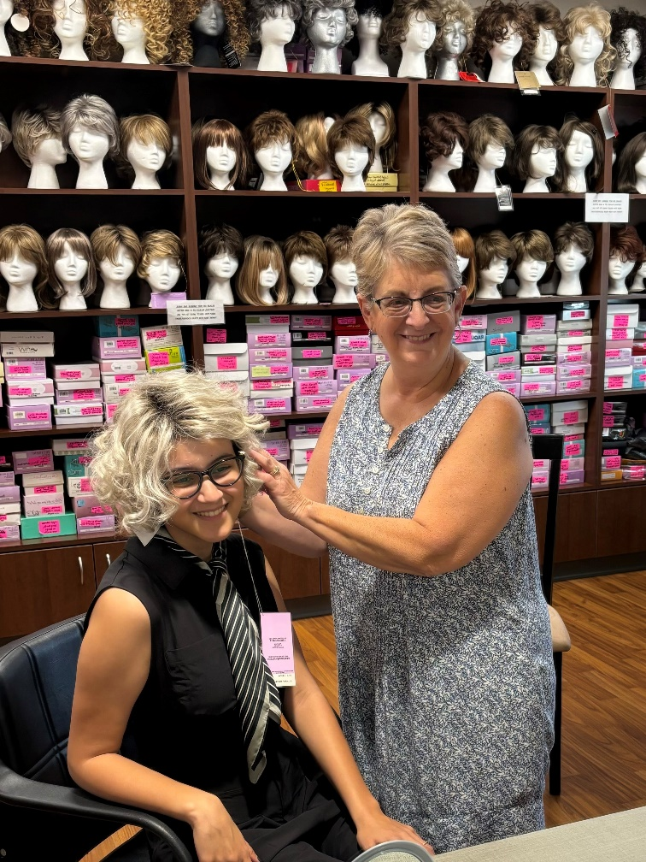
The Victory Center proudly gave away nearly 300 FREE wigs in 2024!
Presented by

Slide 19
A SPECIAL THANK YOU TO OUR
Catwalk Sponsors

Slide 20
Audio Visual Support by:
Presented by

Slide 21
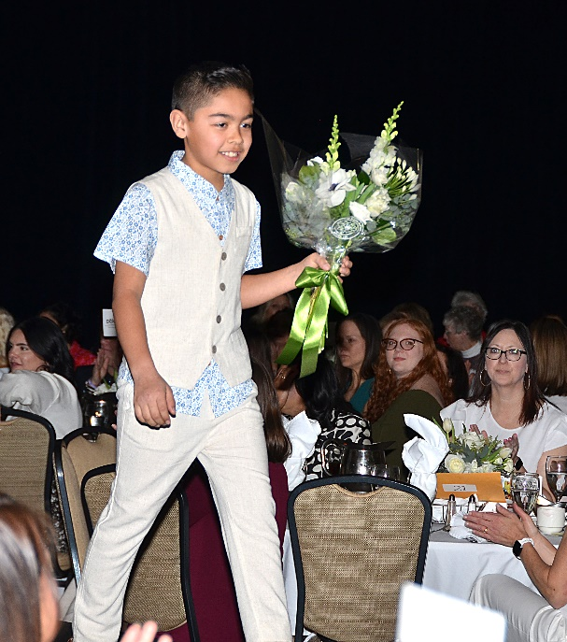
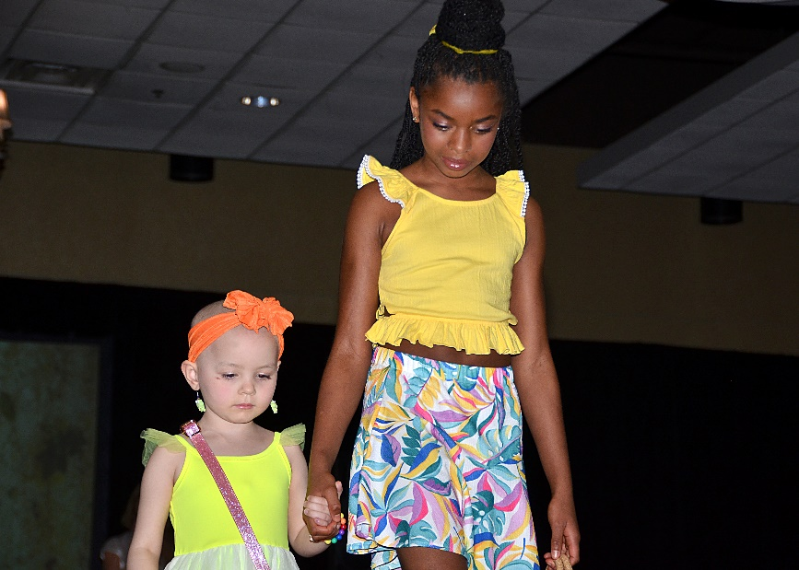
Meet Today’s Child & Teen Models
Kennedy Johnson
Wesley Pietscher
Evie Croniser
Baylor Davis
Hudson Davis
Hunter Davis
Emmarie Dove
Lily Frankhouse
Kelly Harden
Reese Harden
Yale Kuhn
Jax O’Brien
Kevin O’Brien
Kinslee Ogdahl
Mia Paulino
Presented by

Slide 22
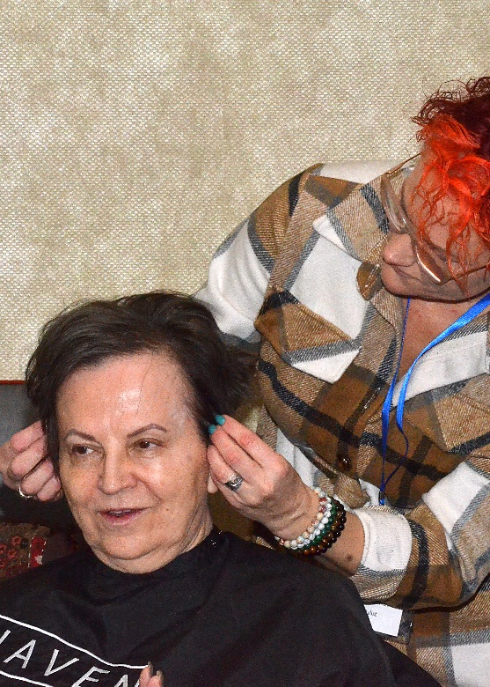
Hair & Make-up Services Provided by:
Soto Salon
Merle Norman
Kristin Comer
Christy Owed
Summit Academy
Presented by

Slide 23
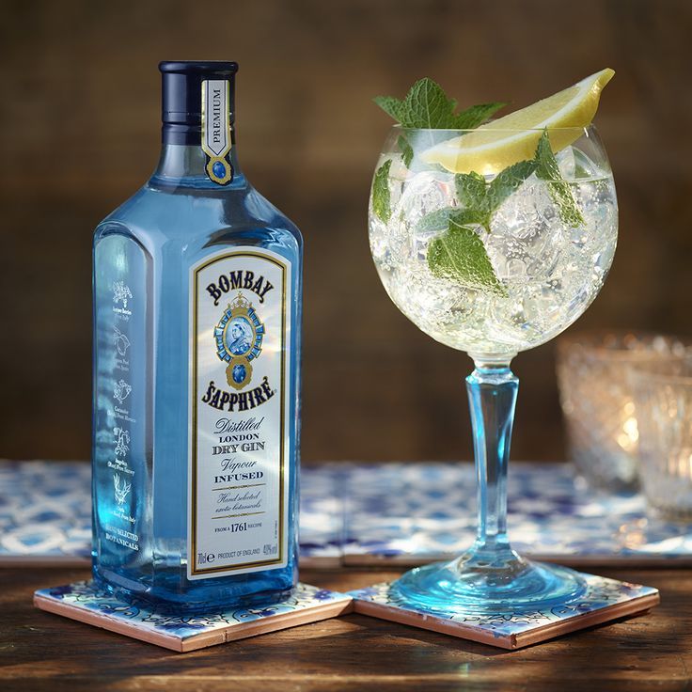
Try our Signature Cocktail: The Sapphire Gin & Tonic!
$1 of every drink sold goes back to The Victory Center!
Presented by

Slide 24
A SPECIAL THANK YOU TO OUR
Catwalk Sponsors

Slide 25
The Victory Center Board of Directors
Paul Clemments, President
Susan Gilmore, Vice President
Hayden Neese, Treasurer
Ann Kujawa, Secretary
Karla Batt
Kevin Bishop
Graham Bluhm
Mindy Campbell
JP Gurnee
Stephanie Holliday-Ball
Shannon Joyce
Regina Kynard
Sarah Nadolny
Jim Perlman
Chris Reamsnyder
Presented by

Slide 26
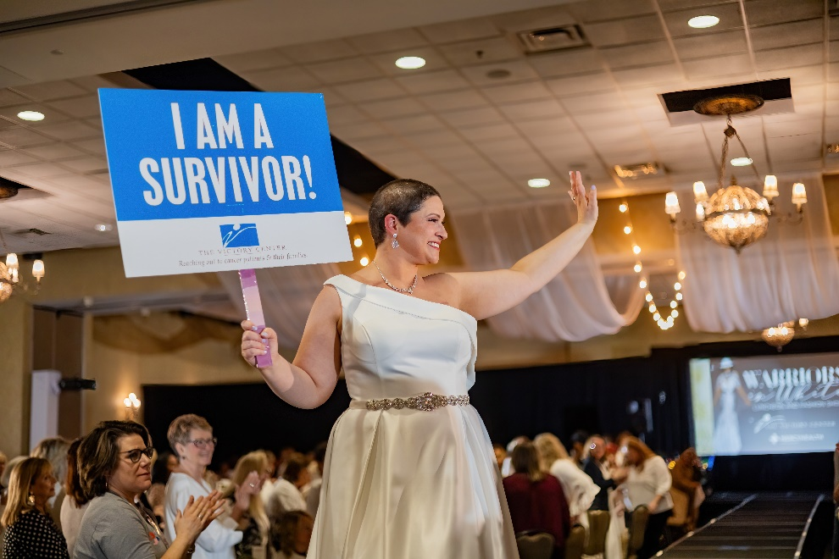
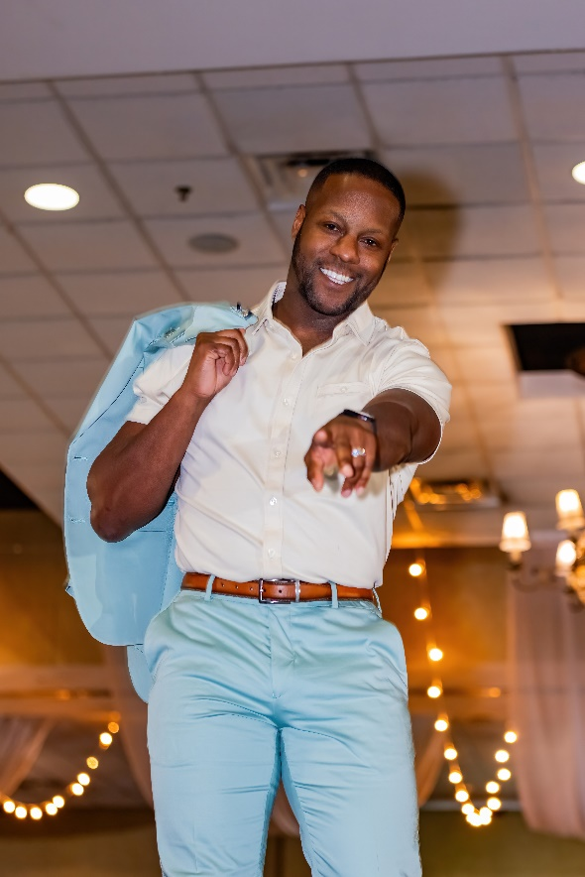
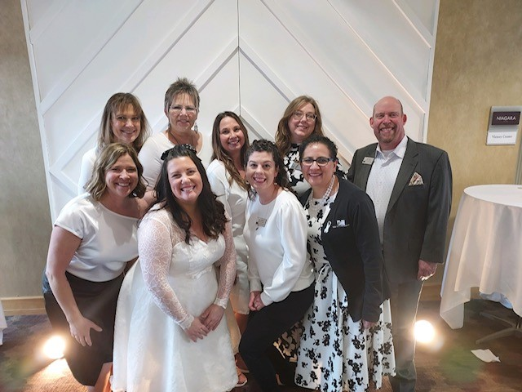
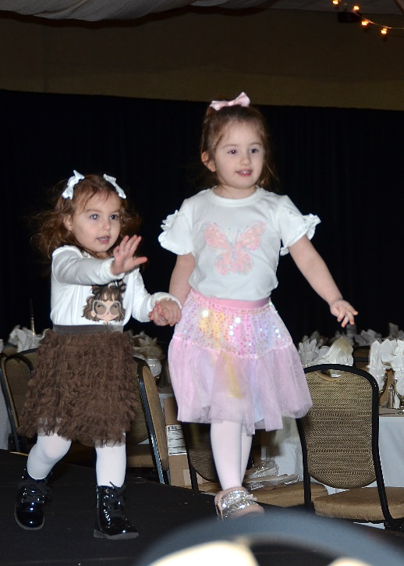
Remembering:
Warriors in White 2024
Presented by

Slide 27
A SPECIAL THANK YOU TO OUR
Catwalk Sponsors

Slide 28
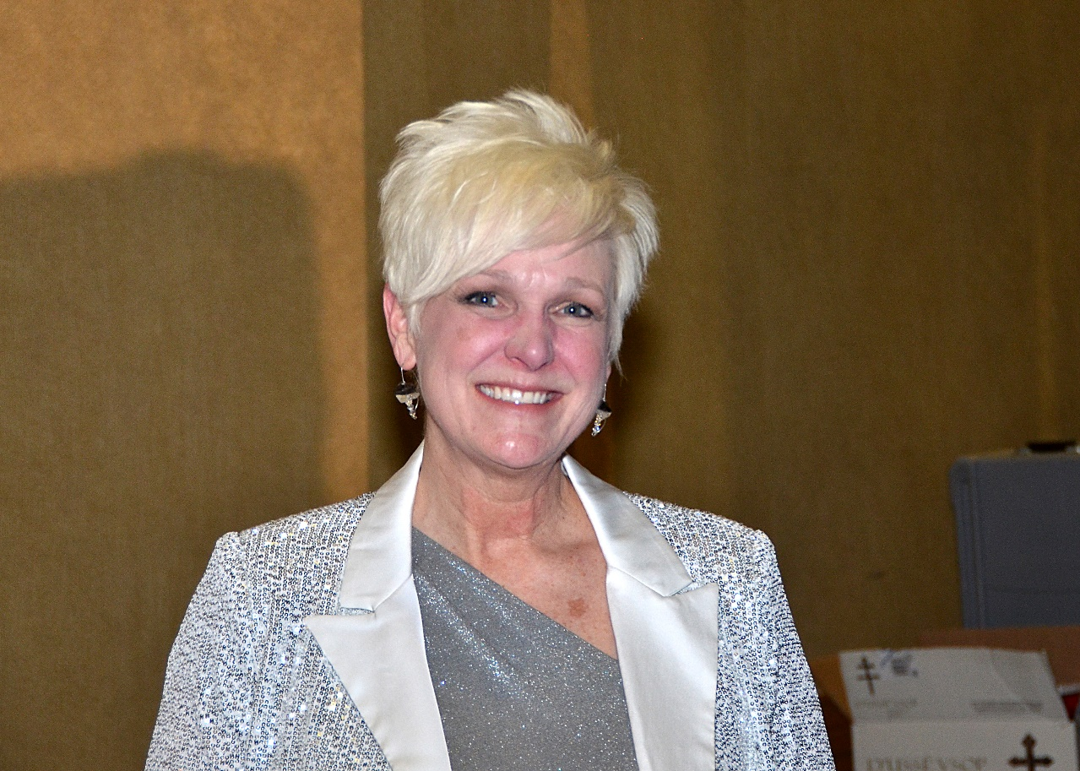
Master of Ceremonies
Chrys Peterson
For 20 years, Chrys Peterson was the face of WTOL news, anchoring the station’s evening newscasts, where she earned numerous awards and was inducted into the Associated Press Broadcasters Hall of Fame.
Her focus now is on Chrys Peterson Consulting where she teaches a variety of programs that help individuals develop and thrive, and that help businesses achieve success through leadership, communication, teamwork, employee engagement, and ambassadorship.
This is her fifteenth year emcee-ing this event!
Presented by

Slide 29
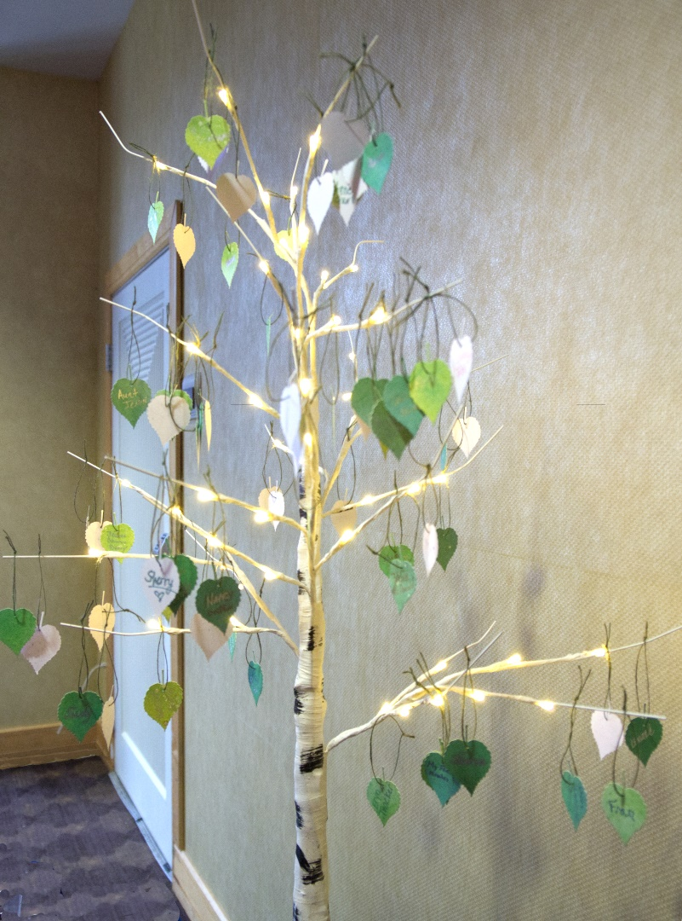
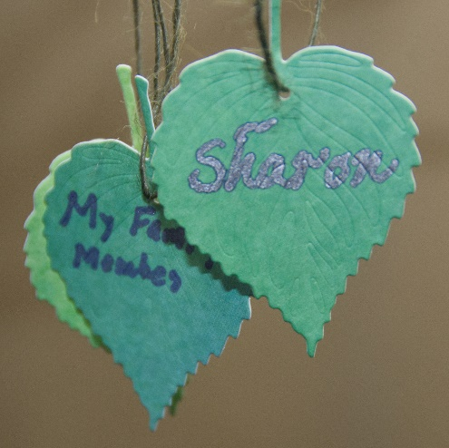
Write the name of a loved one you’ve lost to cancer on a leaf in the lobby.
Names will hang on our Hope Tree at The Victory Center in Toledo.
Presented by

Slide 30
A SPECIAL THANK YOU TO OUR
Catwalk Sponsors

Slide 31
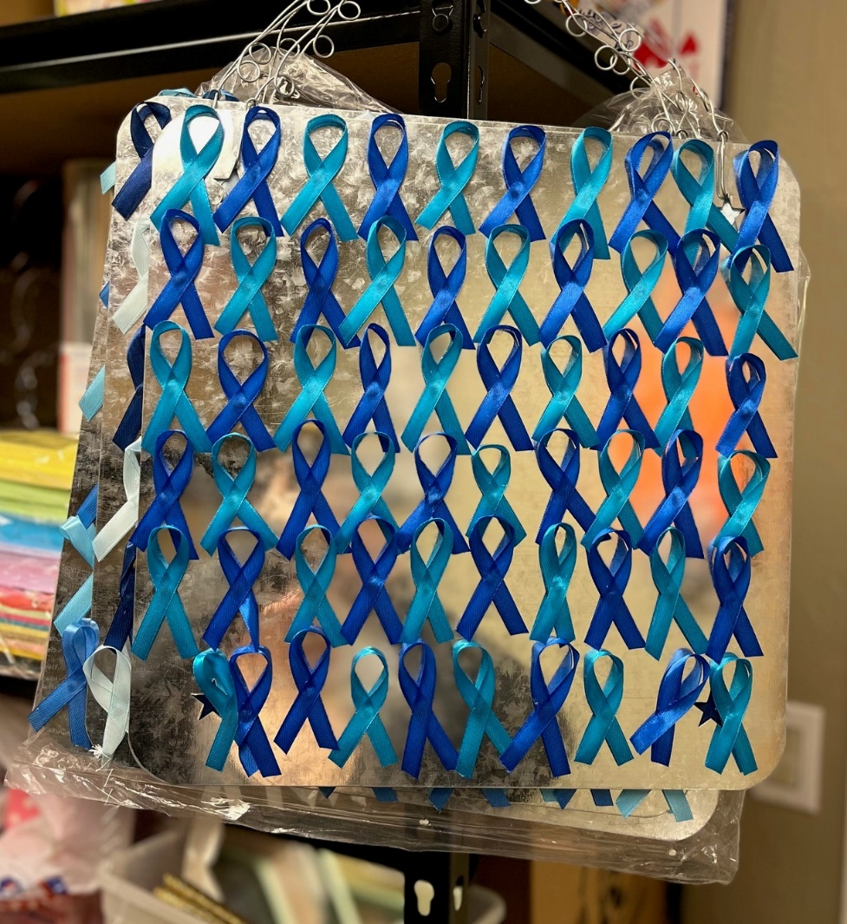
All cancer survivors receive a ribbon to wear and (1) entry into our Survivor Raffle.
Presented by

Slide 32
A SPECIAL THANK YOU TO OUR
Table Sponsors
Becky & Wayne Johnson

Slide 33
A SPECIAL THANK YOU TO OUR
Table Sponsors
Penny Kice
Marcia Stager

Slide 34
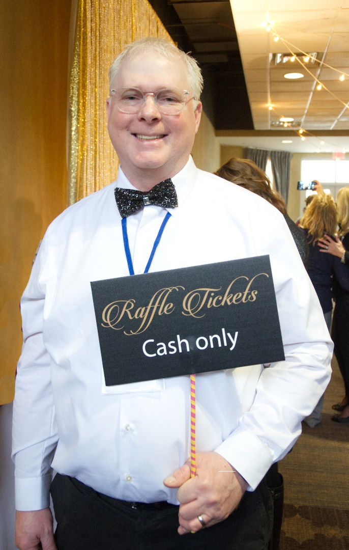
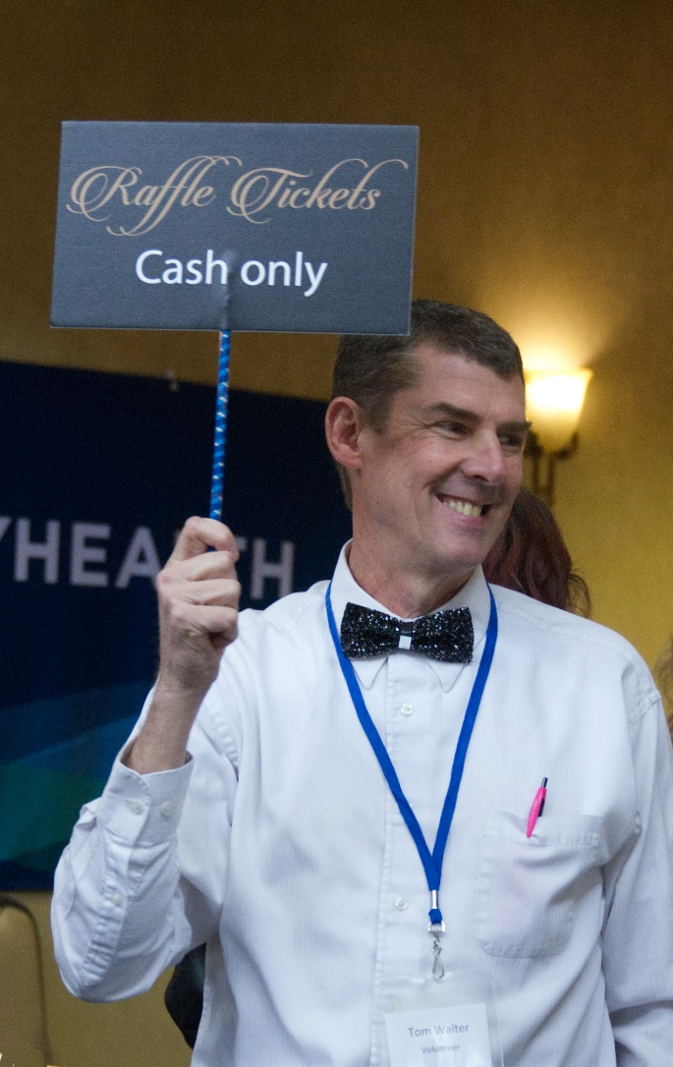
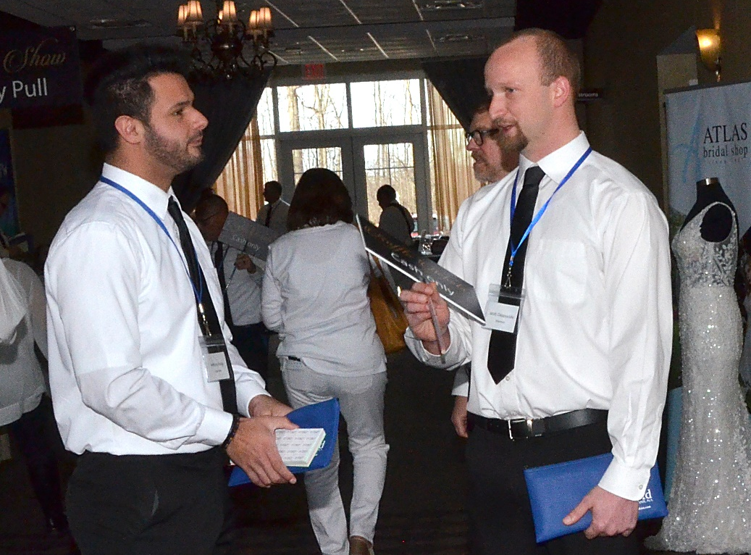
So grateful for our handsome Tie Guys!
Presented by

Slide 35
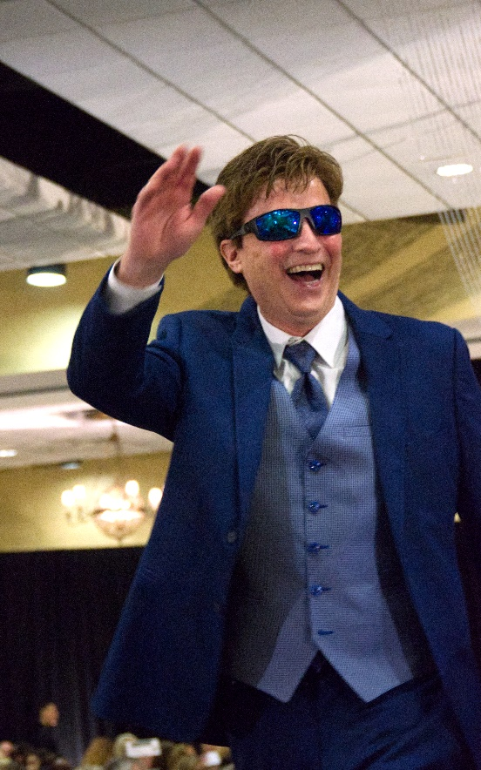
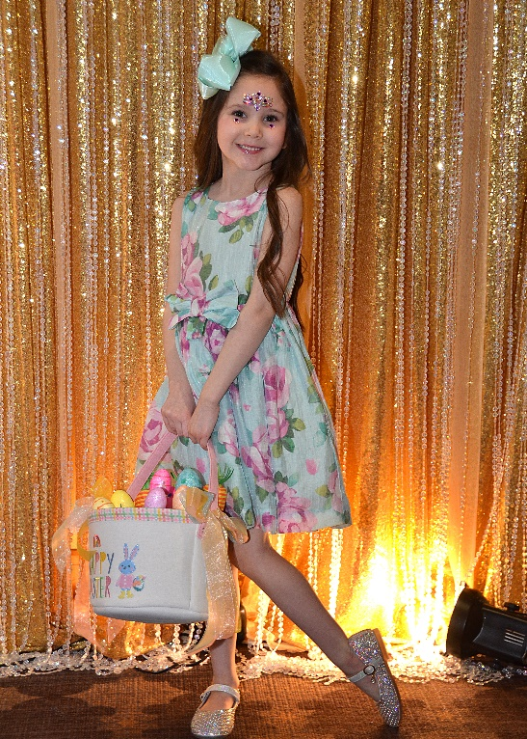
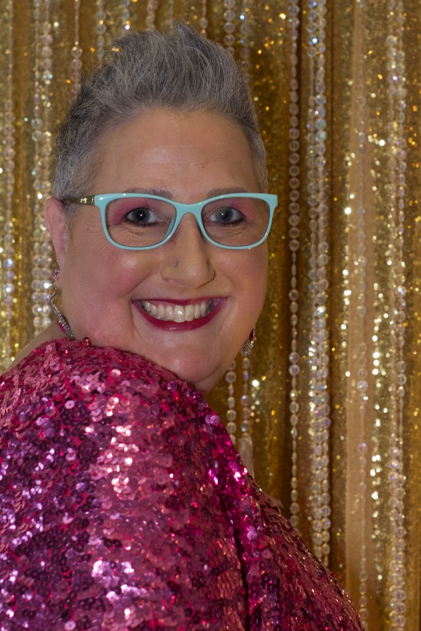
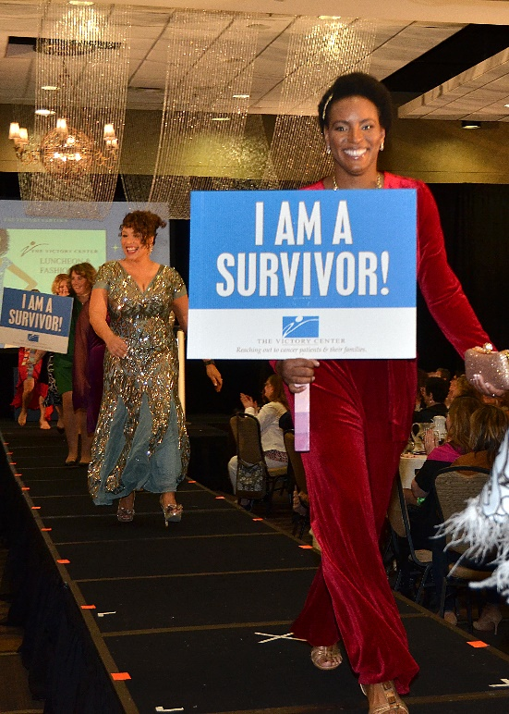
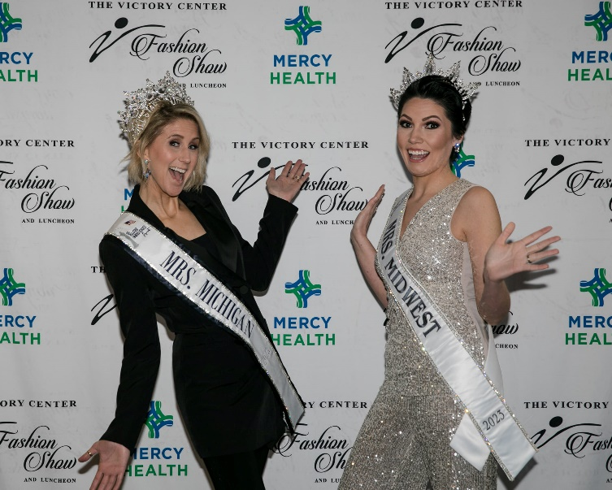
Remembering:
Glamorous in Glitter 2023
Presented by

Slide 36
Music by DJ Doug Kwiatkowski

Slide 37
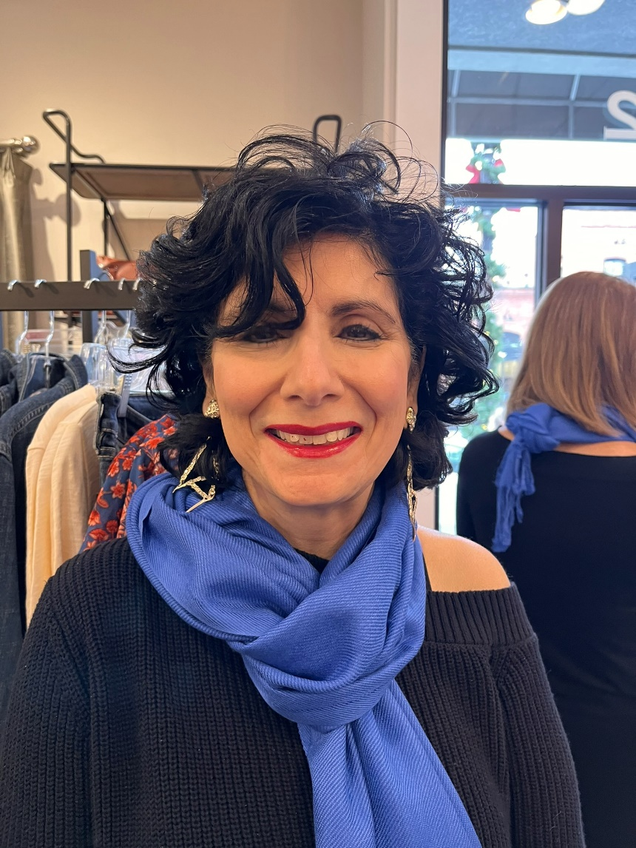
Today’s Featured Survivor Speaker is Mona Shousher
Presented by

Slide 38
Specialty Raffle
See the manila folder at your table for instructions on how to enter to win!
Presented by

Slide 39
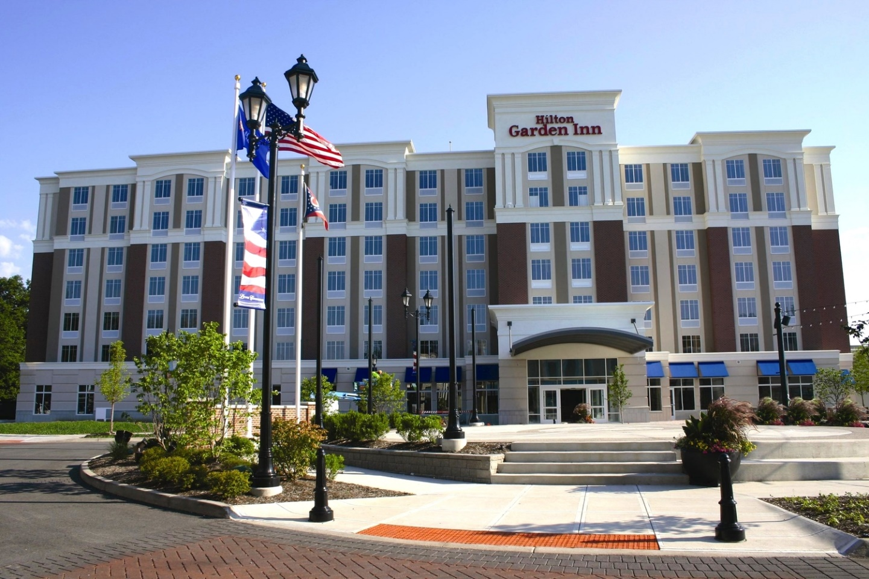
Special thanks to Sheri & team!
Presented by

Slide 40
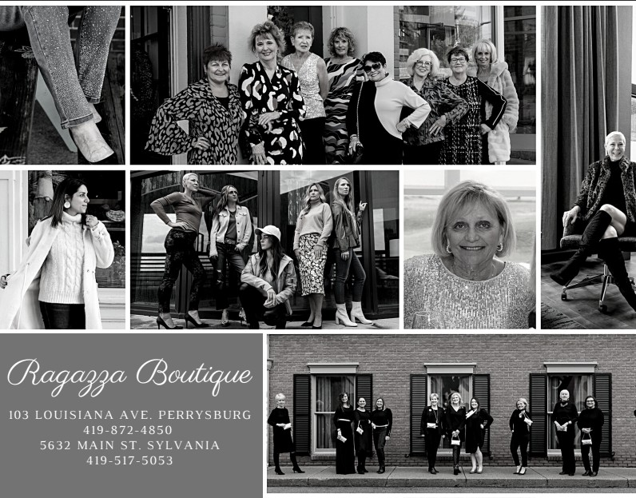
350 pairs of simulated sapphire & diamond earrings were donated by Ragazza!
Presented by

Slide 41
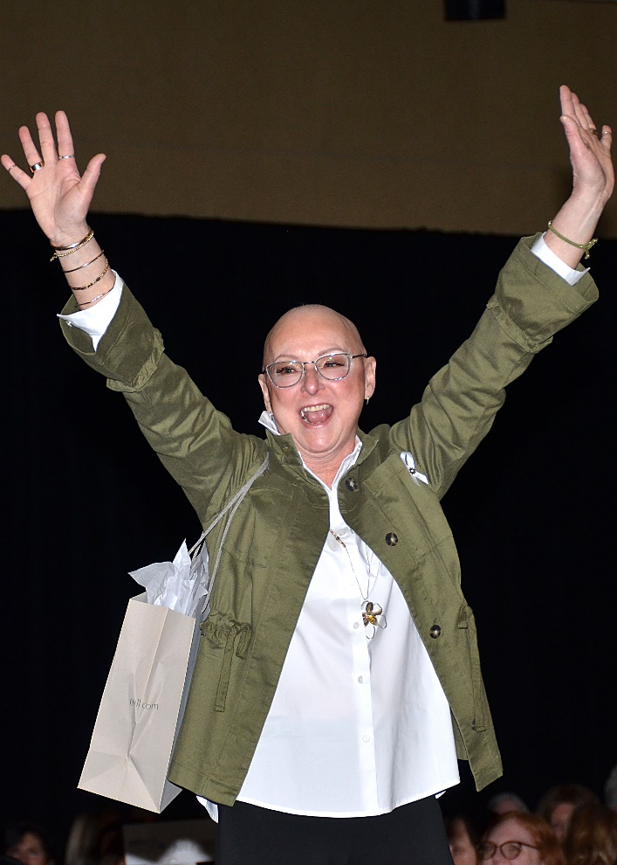
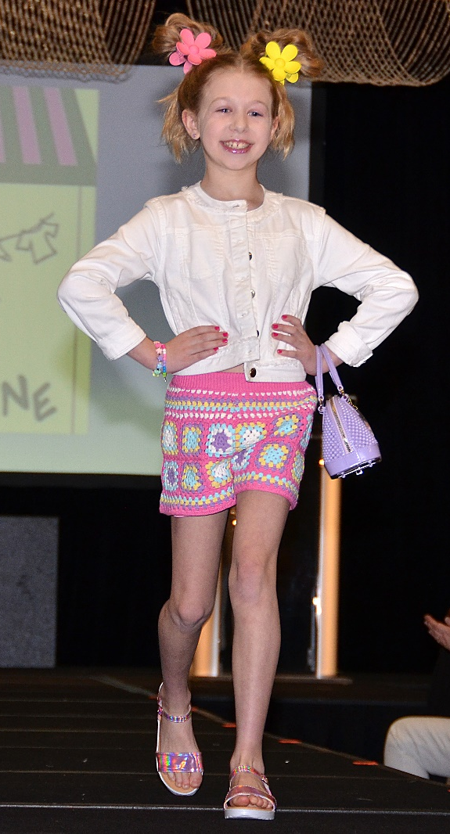
Thanks to our event photographers: Jerry Finfera Kurt Nielsen Katie Wagner

Slide 42
Save the Dates!
Celebrity Wait Night
Thursday, May 15, 2025
Celebrity Wait Night Defiance
Thursday, October 23, 2025
Over the Edge for Victory
Friday & Saturday, Sept 5 & 6, 2025
Luncheon & Fashion Show
Coming in 2026

Slide 44
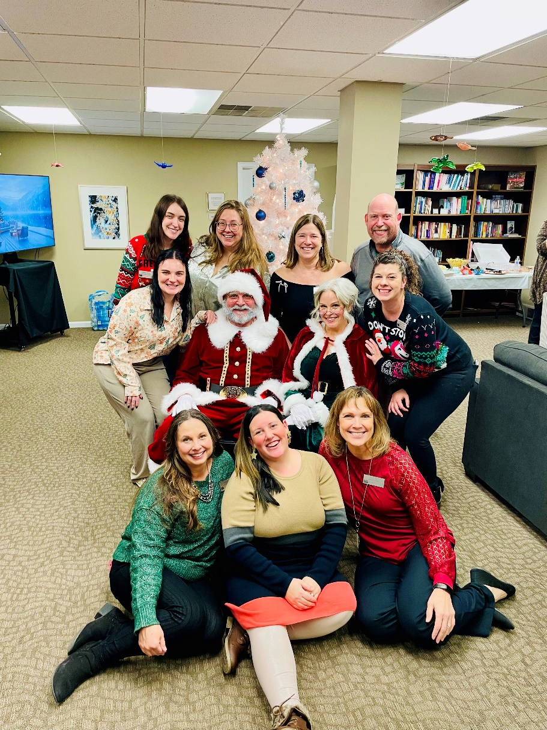
The Victory Center’s Amazing Staff!
Dianne Barndt
Jessica Bidwell
Jason Griffin
Lindsay Haynes
Sydney Kenworthy
Hattie Lykowski
Lisa Rasey
Kimberly Rosinski
Sandy Witt
Presented by

Slide 45
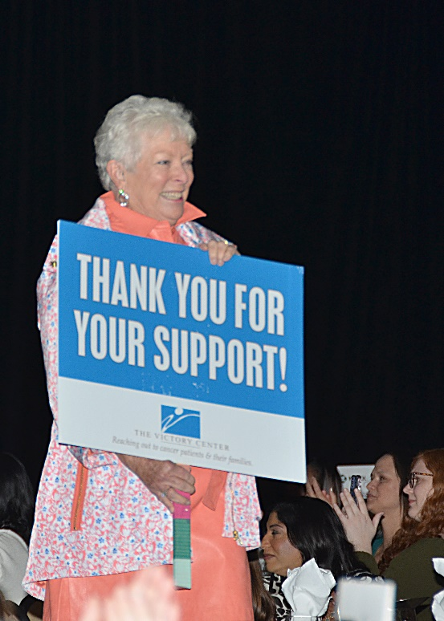
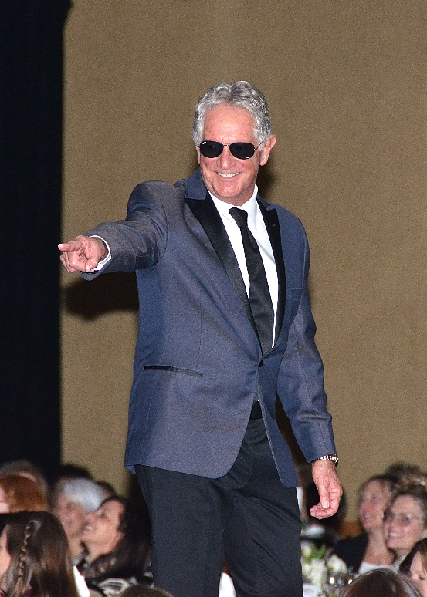
Friends of TVC Models
Dr. Anita Antoniolli
Angie Ash
Chantal Crane
Dan Cummins
Dr. Shaili Desai
Dr. Kara Hertzfeld
Ella Hertzfeld
Cortney Howard
Ann Kisin
Kalie Marantette
Sharon Mayorquin
Claire Mitchell
Chris Reamsnyder
Marina Sedlar
Dr. F. Nicholas Shamma
James Starks
Presented by

Slide 46
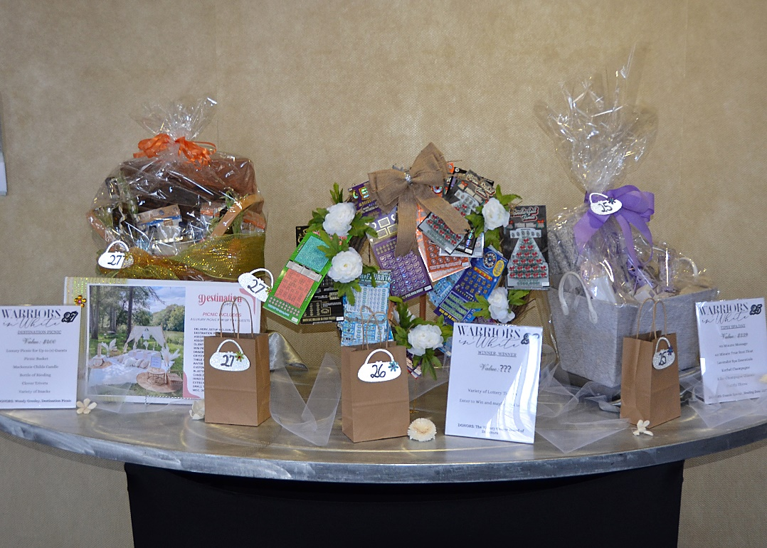
Thank you to our MANY raffle donors!
Presented by

Slide 47
SPECIAL THANKS!
Presented by

